Slide 1



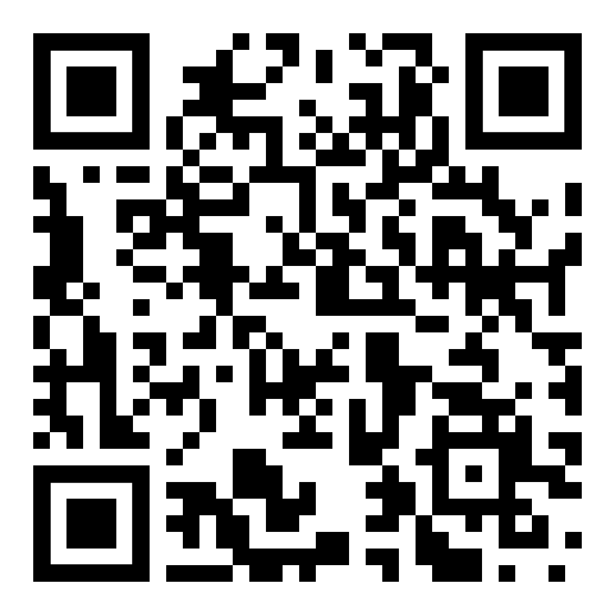
Help support the ministry of Skylark by participating in the Baby Bottle Campaign!
TWO WAYS TO GIVE:
Pick up a bottle, fill it with coins, cash, or a check, and return it on Father’s Day.
-OR-
Scan the QR code to give online.

Slide 2

Please return your filled bottles
next week!

